Slide 1

Defensive Security Project
by: TEAM ROCKET
Niccolo Arboleda, Kevin Dyal, Muhammad Shakeel, Darwin Hawezi, Aquib Ajeem

Slide 2


Slide 3



Table of Contents
This document contains the following resources:
Monitoring Environment
Attack Analysis
Project Summary & Future Mitigations
Notes:
alerts > analysis > summary

Slide 4


Risk Monitoring Environment
‹#›

Slide 5
Scenario
Team Rocket has been hired as a SOC (Security Operations Center) analyst team for Virtual Space Industries (VSI), a company specializing in designing virtual-reality programs for businesses. VSI has heard rumors that its competitor, JobeCorp, may be planning to launch cyber attacks aimed at disrupting VSI’s business operations. Our role, is to utilize Splunk, a security information and event management (SIEM) tool, to monitor for potential attacks on VSI's systems and applications.
Our responsibilities include monitoring an Apache web server that hosts the administrative webpage and a Windows operating system that runs many of VSI’s back-end operations. To assist us VSI’s networking team has provided past logs which will help us develop baselines, and create reports, alerts, and dashboards. The logs we have been provided include Windows Server Logs, which contain intellectual property related to VSI’s next-generation virtual-reality programs, and Apache Server Logs, which are related to VSI’s main public-facing website, vsi-company.com.

Slide 6
IPQS Threat Risk Scoring App
‹#›

Slide 7
IPQS Threat Risk Scoring
IPQS Threat Scoring Add on for Splunk allows for improved threat intelligence through IP address reputation, email address risk scoring, domain intelligence, and malicious URL scanning within Splunk.

Slide 8
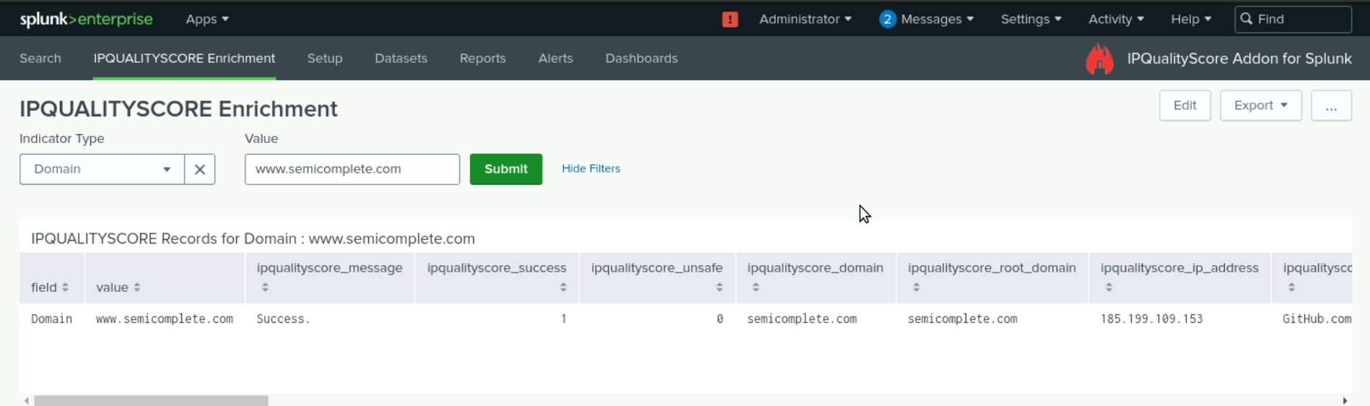
IPQS Threat Risk Scoring
A scenario to use this app is when there are domains, IP Address, e-mails, Phone Numbers, or URLs that you want more data on, it is easily searched using IPQS in order to enrich the data.
A domain specific to the data we were handling is www.semicomplete.com.

Slide 9
Logs Analyzed
Windows Logs
Apache Logs
1
2
Signature ID and Signatures
Users
Statuses
High Severity Events
HTTP Method
Referer_Domains
HTTP Response Status
Client IP / Geo-Locations
User Agents

Slide 10
Windows Logs
‹#›

Slide 11
Reports—Windows
Designed the following reports:
Report Name | Report Description
Signature Report | Evaluates the signatures in Windows Event Logs. Focus on Signature 4624 & 4743.
Users Report | Identifies users in Window Back End Operations. Focus on users _a, _k, and _j.
Status Report | Focuses on Windows process and their success or failure outcomes.
Severity Report | Identifies the number of logs that are critical (high) warnsing or informative.
Notes:
4624 - Successful Logon 4743 - Account Deletion

Slide 12
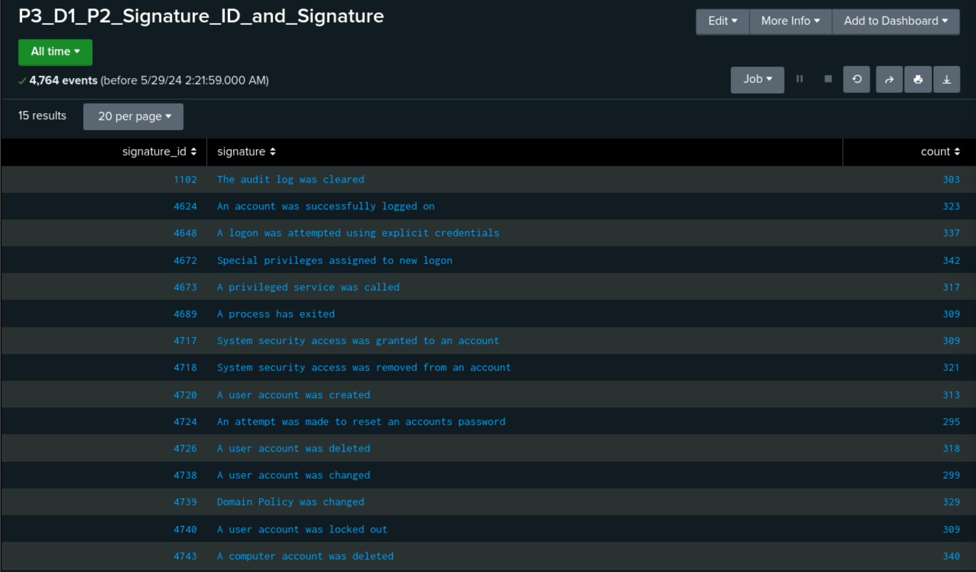
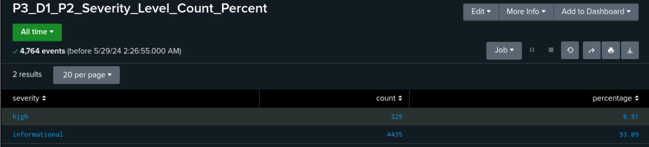
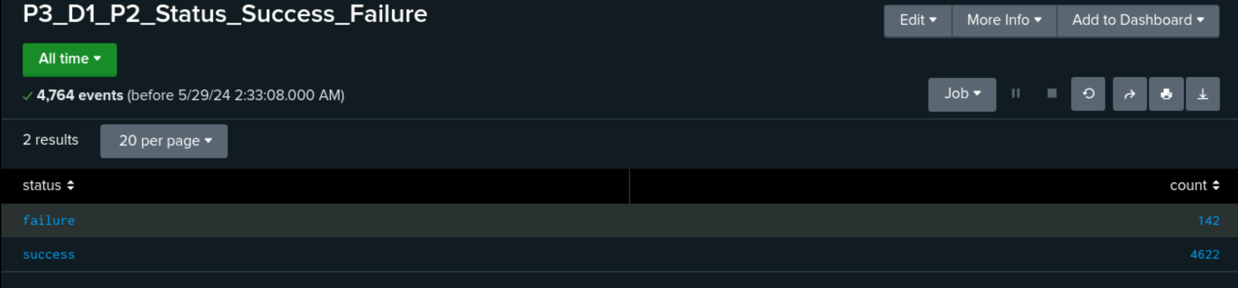
Images of Reports—Windows

Slide 13
Alerts—Windows
Designed the following alerts:
Alert Name | Alert Description | Alert Baseline | Alert Threshold
Alert for Failed Windows Activities | Provides an email alert when Failed Windows Activity go beyond the designated threshold. | 6 | 13
JUSTIFICATION: The baseline was determined by finding the average of failed Windows Activities/hour (142/24=5.9)
The Threshold was created above the highest normal activity of 10, by 3

Slide 14
Alerts—Windows
Designed the following alerts:
Alert Name | Alert Description | Alert Baseline | Alert Threshold
Alert for Signature 4624 | Provides an email alert when Number of Successful Logins go beyond the designated threshold. | 14 | 23
JUSTIFICATION: The baseline was determined by finding the average of ‘4624’ events/hour
The Threshold was created above the highest normal activity of 20, by 3

Slide 15
Alerts—Windows
Designed the following alerts:
Alert Name | Alert Description | Alert Baseline | Alert Threshold
Alert for Signature 4726 | Provides an email alert when Number of Deleted Accounts go beyond the designated threshold. | 14 | 25
JUSTIFICATION: The baseline was determined by finding the average of ‘4726’ events/hour
The Threshold was created above the highest normal activity

Slide 16
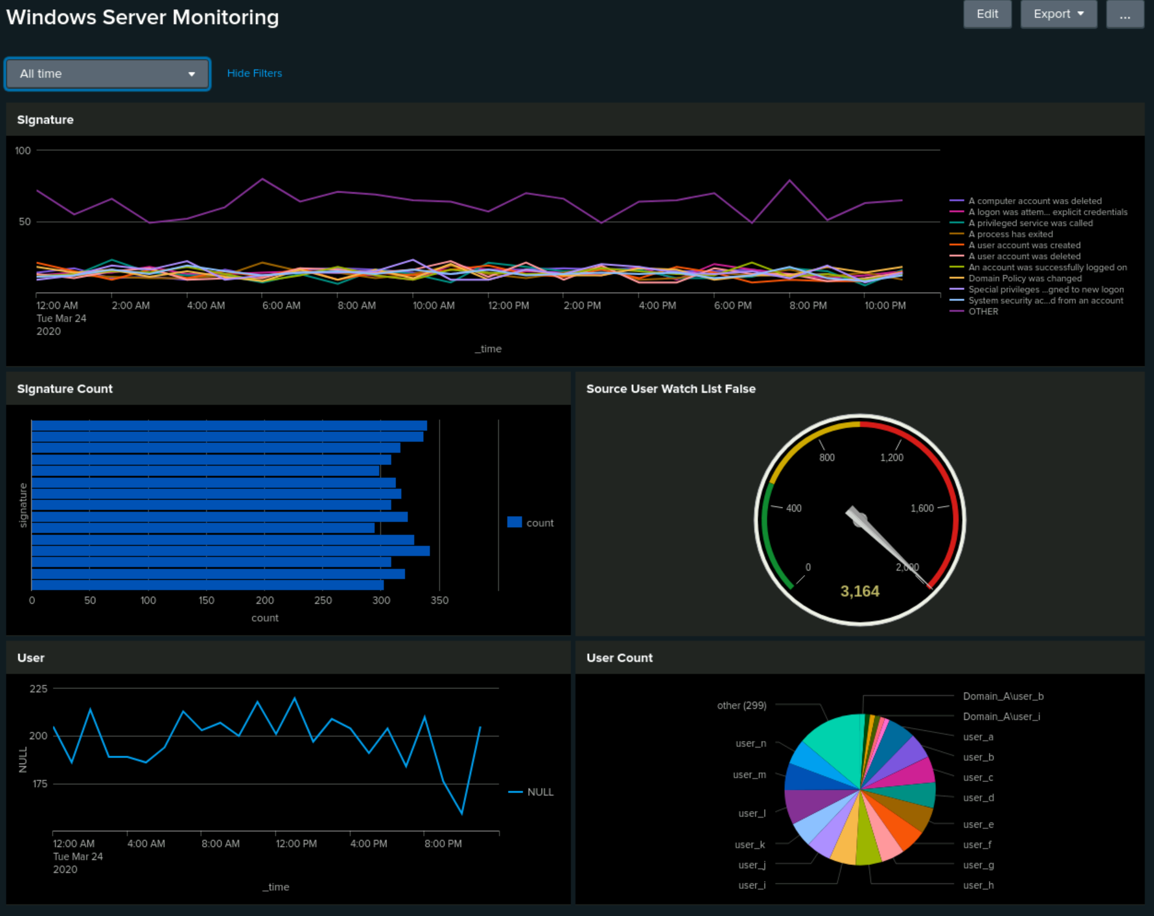
Dashboards—Windows

Slide 17
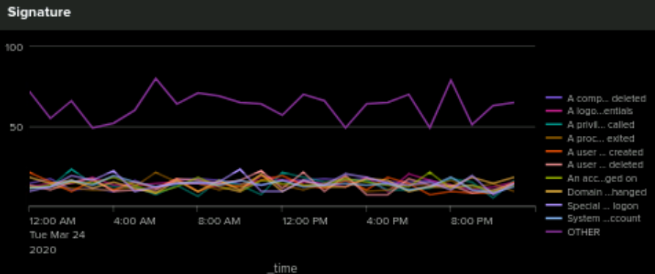
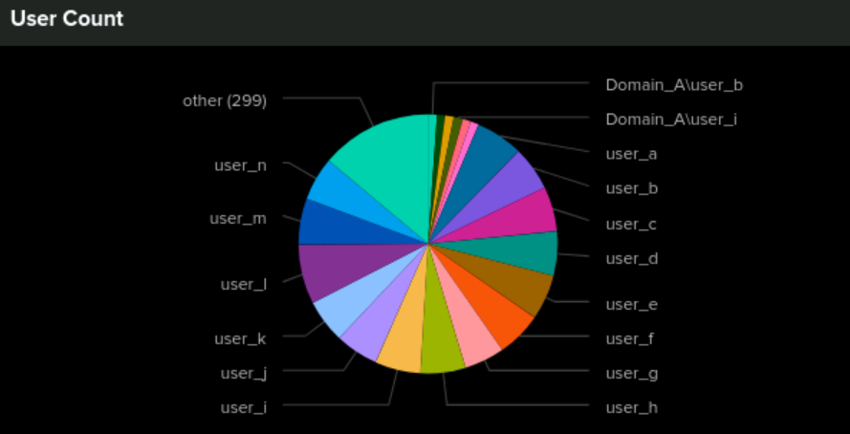
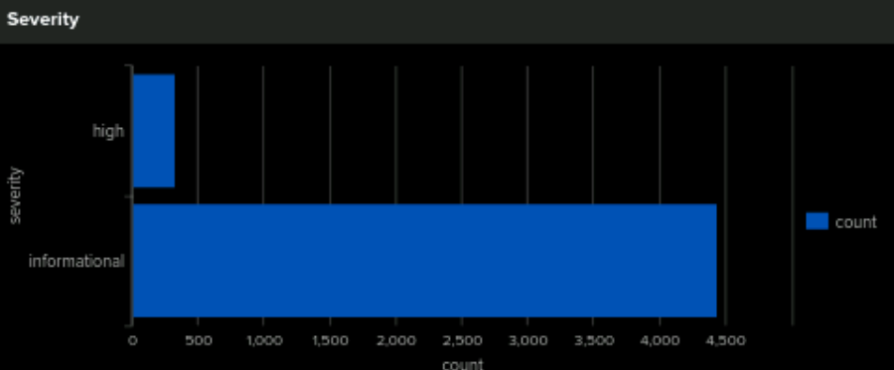
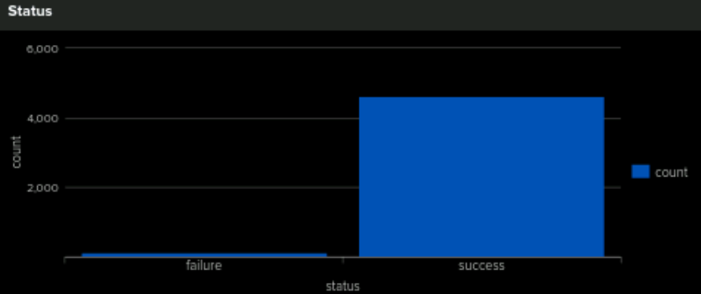
Dashboards—Windows
Place image here
Place image here
Place image here
Place image here
Notes:
OTHER not ideal

Slide 18
Apache Logs
‹#›

Slide 19
Reports—Apache
Designed the following reports:
Report Name | Report Description
HTTP Methods | Gathers a count of the different HTTP methods being logged
Referrer_Domains | Evaluates vsi-company.com and how the site directs users to other webpages
HTTP Response / Status | Evaluates HTTP Response Codes that the server is putting out
Client IPs / Geo-Locations | Shows IP address of clients to vsi-company.com and their Geo-Locations

Slide 20
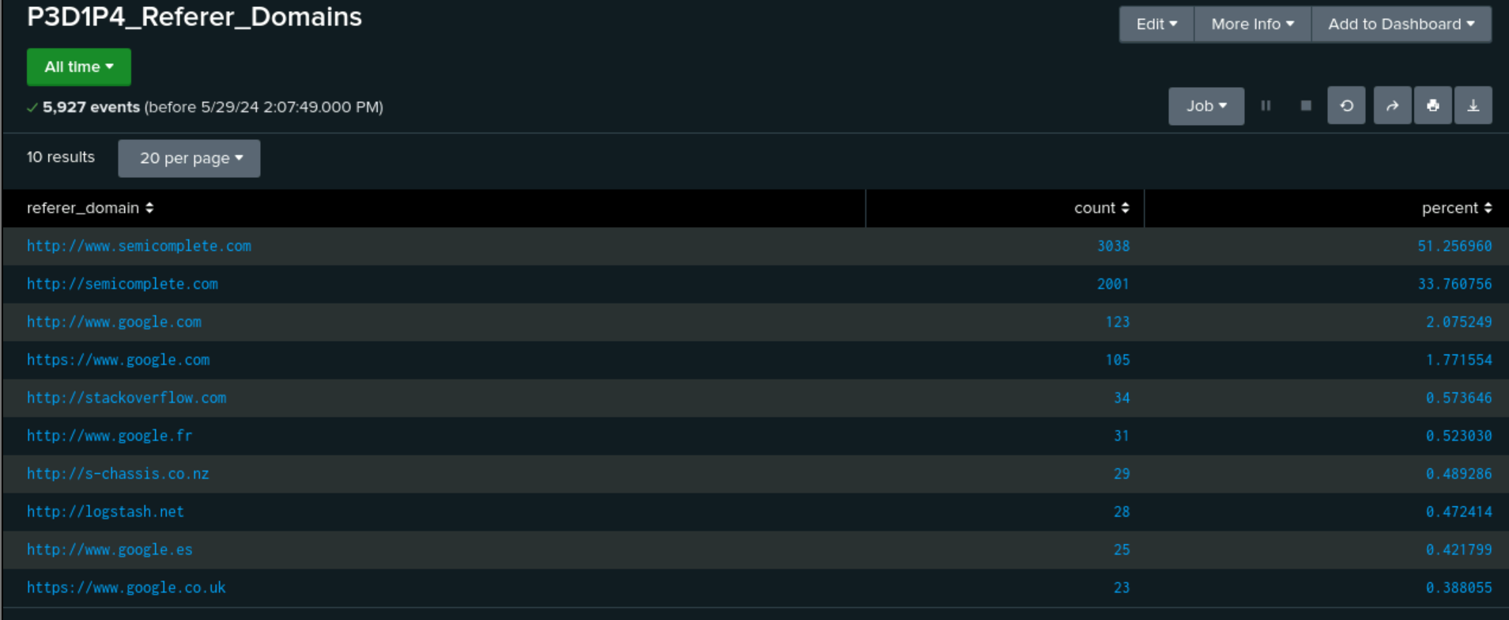
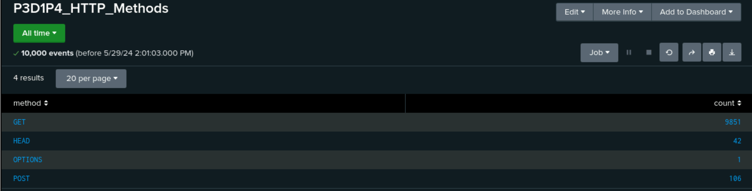
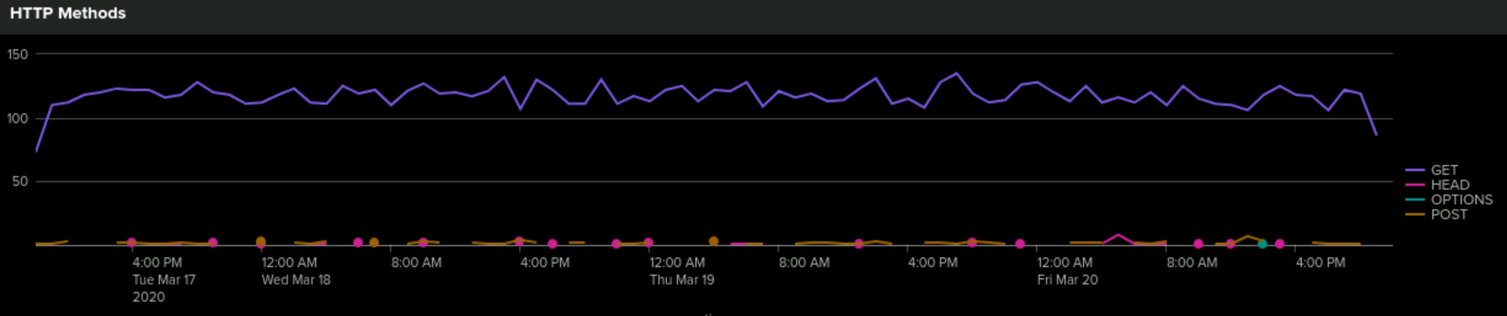
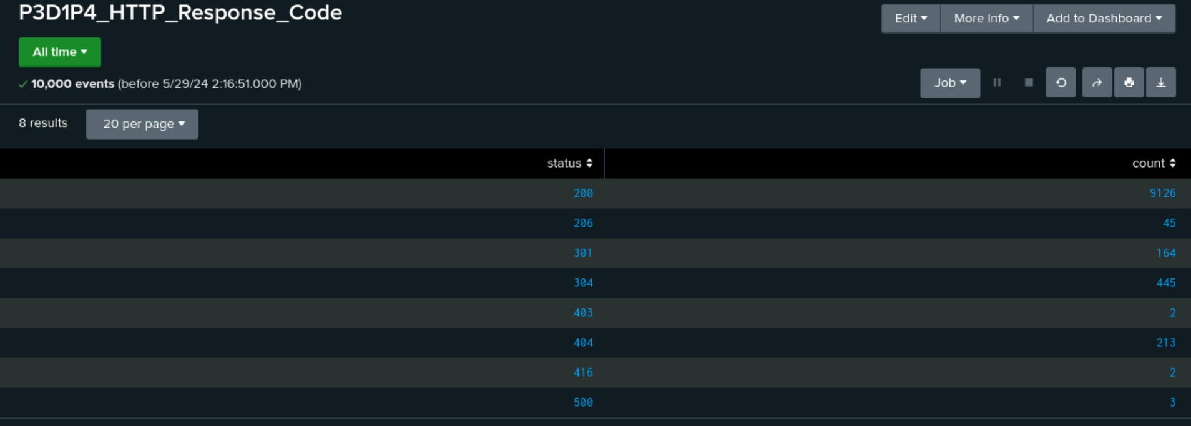
Images of Reports—Apache

Slide 21
Alerts—Apache
Designed the following alerts:
Alert Name | Alert Description | Alert Baseline | Alert Threshold
Alert for Countries outside USA | Provides an email alert when Number of Countries outside the USA go beyond designated threshold. | 256 | 340
JUSTIFICATION: The baseline was determined by finding the average of activities outside the US/hour
The Threshold was created above the highest normal activity

Slide 22
Alerts—Apache
Designed the following alerts:
Alert Name | Alert Description | Alert Baseline | Alert Threshold
Alert for HTTP POST | Provides an email alert when Number of HTTP POST requests go beyond the designated threshold. | 5 | 13
JUSTIFICATION: The baseline was determined by finding the average POST’s in a day / hour
The Threshold was created above the highest normal activity of 10

Slide 23
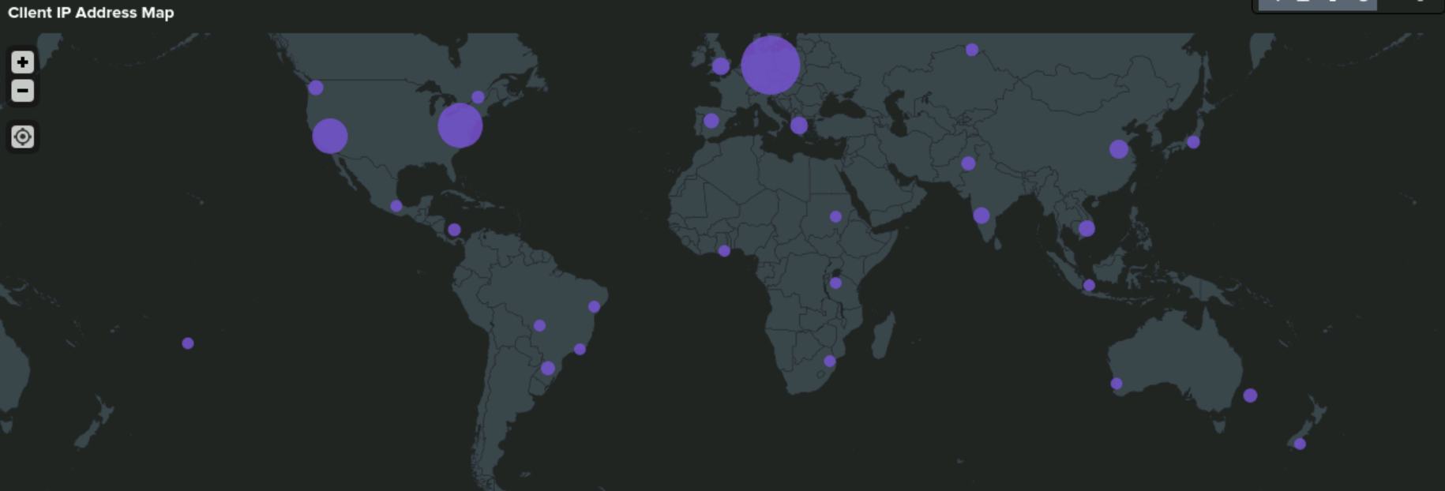
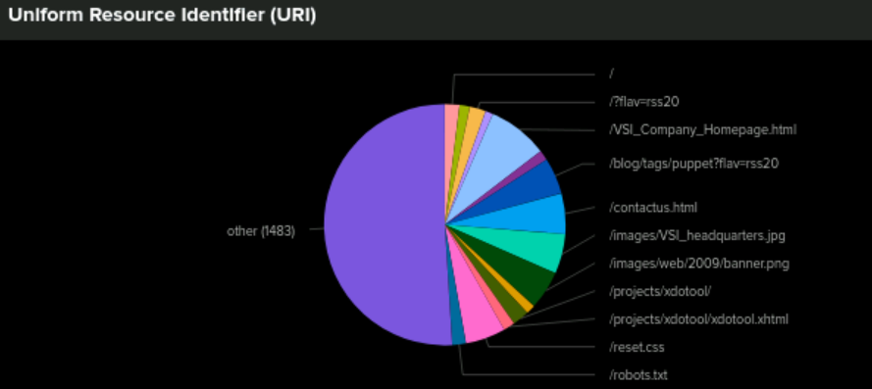
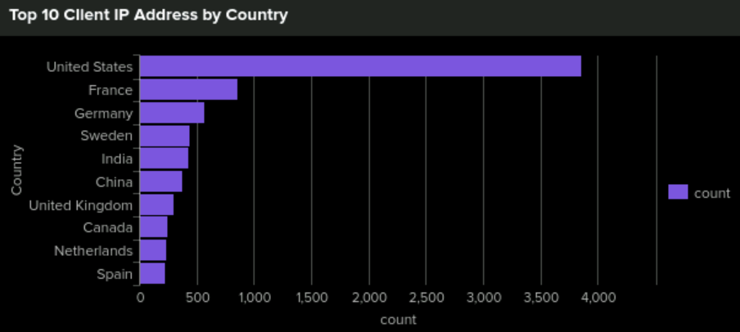
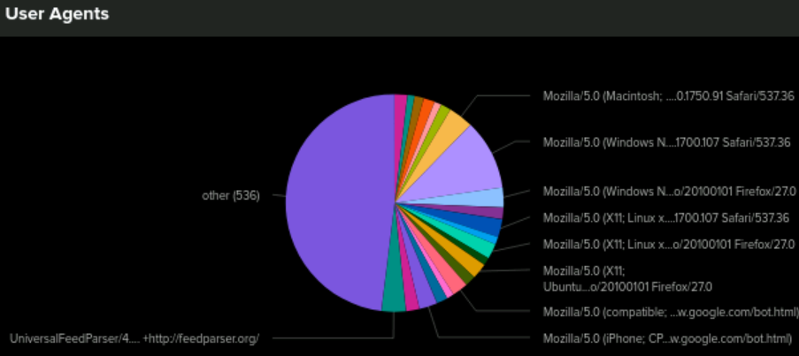
Dashboards—Apache
Place image here
Place image here
Place image here
Place image here

Slide 24
Attack Analysis
‹#›

Slide 25
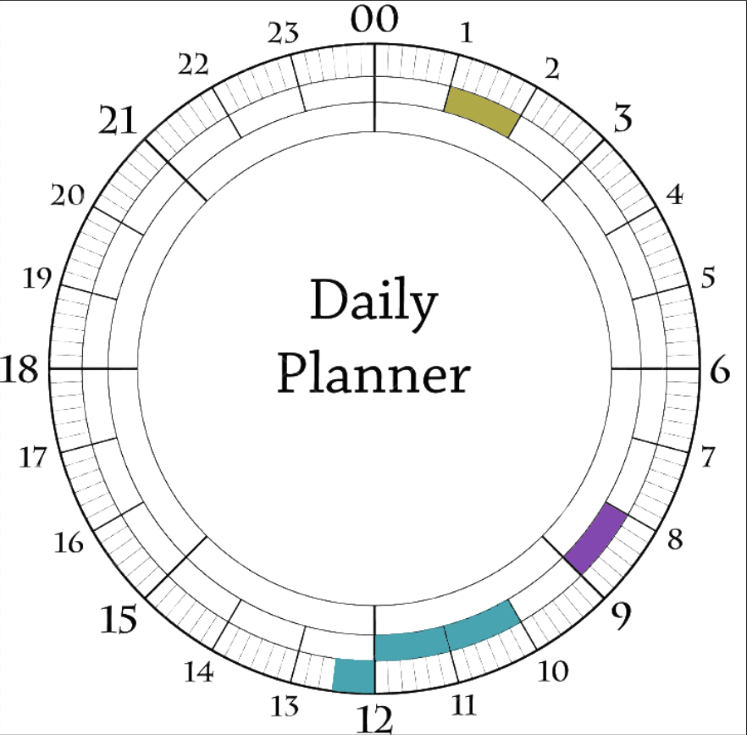
Attack Summary—Windows
The majority of Windows process failures peaked between 8 and 9 AM With 35 logs recorded
High Severity counts went up from 329 to 1111
We noticed zero successful logins between 10:00 AM and 12:30 PM as opposed to normal behaviour
We noticed zero deleted account between 10:00 AM and 11:00 AM
The primary users during the attack were user_K, _A, and _J
Notes:
User_a primarily logged in from 1 AM to 3 AM on March 25th, 2020.
Failures at 8am
User_k primarily logged in 10 AM on March 25th, 2020.
User_j primarily logged in from 11 AM to 12 PM on March 25th, 2020.
A J and K sus

Slide 26
Attack Summary—Windows
Alert for Failed Windows Activities: Using a baseline of 6 events and a threshold of 13, our alert was triggered between 8am-9am on March 25th 2020 due to the 35 failed events within the hour.
Alert for Signature 4624 and Alert for Signature 4726: Our alert was NOT successful. We might attempt a minimum threshold as opposed to an upper threshold, but that comes with new challenges like accounting for false positives, weekends and holidays.

Slide 27
Attack Summary—Windows
During the attack, we noticed a sharp increase in failed events which was a clear indicator of suspicious activity. However, the other alerts we had did not trip. This initially led us to believe that there was no cause for suspicion there. However, when visualized the data we saw that there was an anomaly - zero events. Further looking into the dashboards, we saw the spikes in account lockouts and account deletions in the morning prior. Our conclusion is that a password spray attack occurred late at night and a mass account deletion occurred in the early morning that resulted in an overall Denial of Service to the Windows Environment

Slide 28
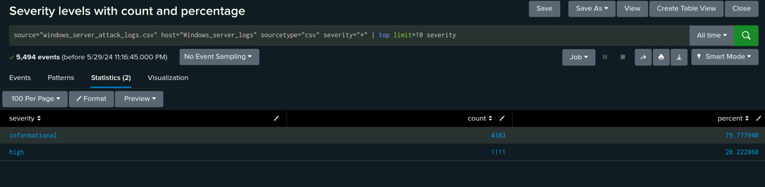
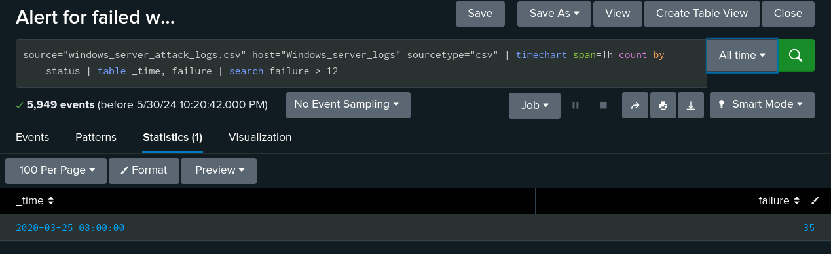
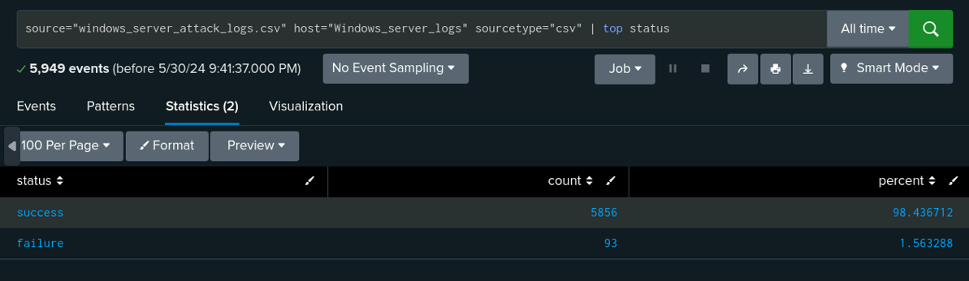
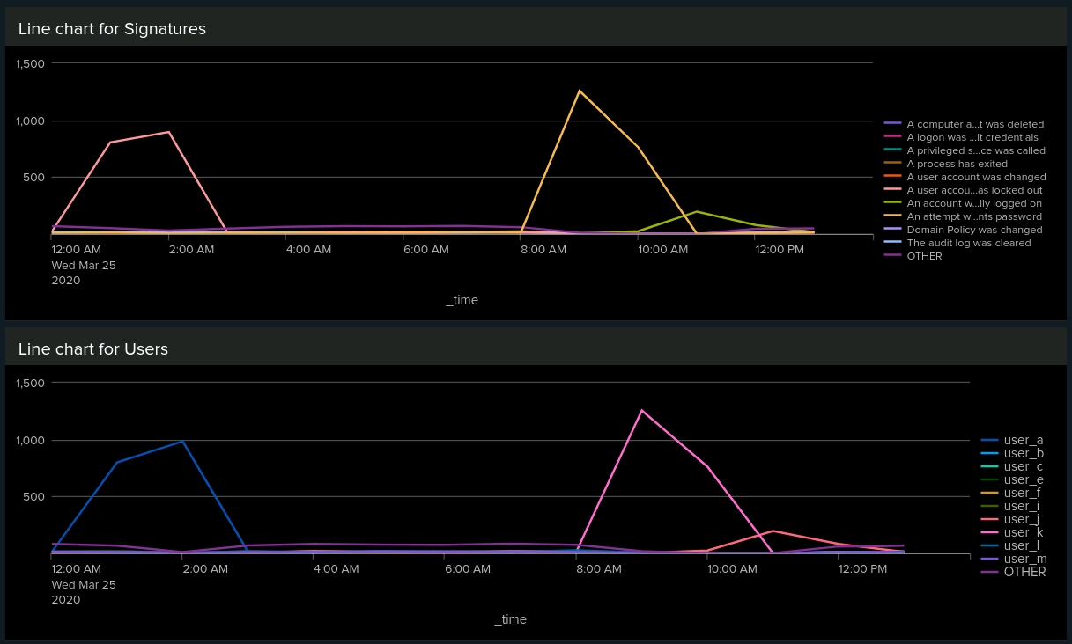
Screenshots of Attack Logs
Post attack report of Severity levels indicate a significant increase in high severity level activities
An alert set for failed windows activity with a threshold of 12 was triggered
Failed Activities reduced in the new dataset, providing us with no reason for suspicion. 142 to 93 failed events.
Time chart indicating an increased number of specific signatures
Notes:
CORRELATION

Slide 29
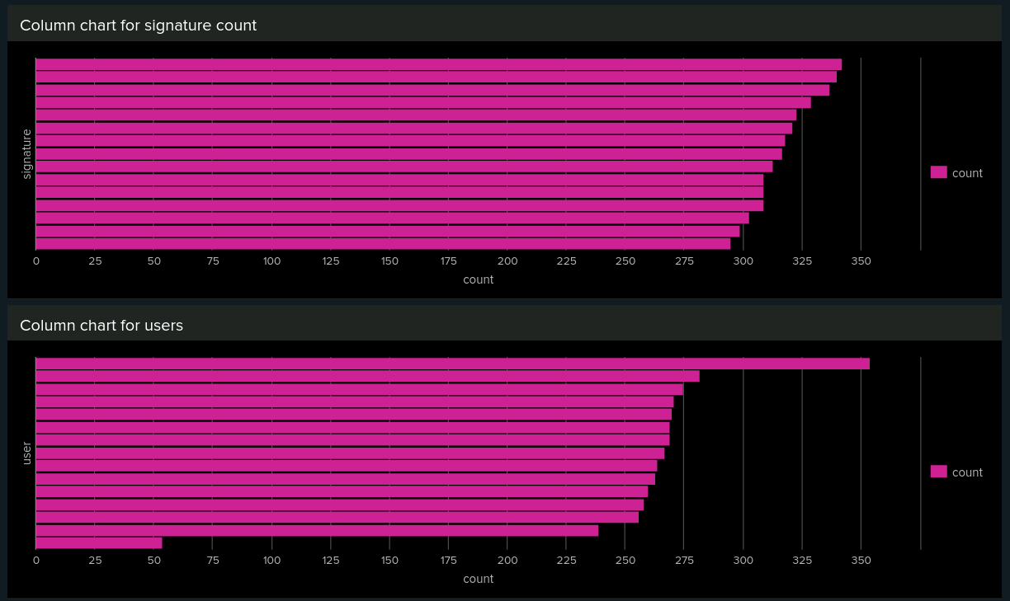
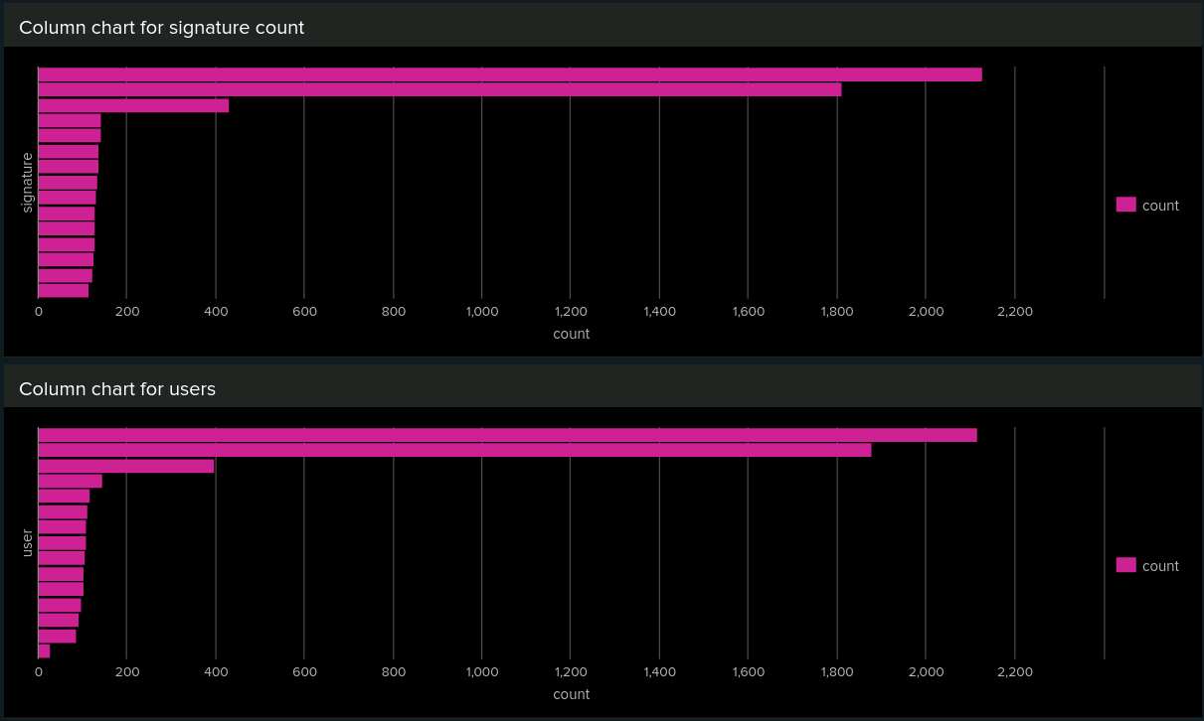
Screenshots of Attack Logs
Column charts indicating count for user activities and signatures on a normal day.
Column charts indicating count for user activities and signatures during the attack.
Notes:
correlation

Slide 30
Attack Summary—Apache
Summarize your findings from your reports when analyzing the attack logs.
There was a significant increase in POST methods.
There was a significant reduction in GET activity.
The www.semicomplete.com referrer domain count went down by 3038 to 764. The semicomplete.com referrer domain count went down by 2001 to 572.
Significant reduction in 200 OK response code 9726 to 3746
Increase in 404 NOT FOUND response codes 213 to 679

Slide 31
Attack Summary—Apache
Summarize your findings from your alerts when analyzing the attack logs. Were the thresholds correct?
We detected a suspicious volume of international activity between 8pm and 9pm.
Our alert would have triggered.
We detected a suspicious volume of HTTP POST activity between 8pm and 9pm on March 25th. It peaked at 1,296.
Our alert would have triggered.

Slide 32
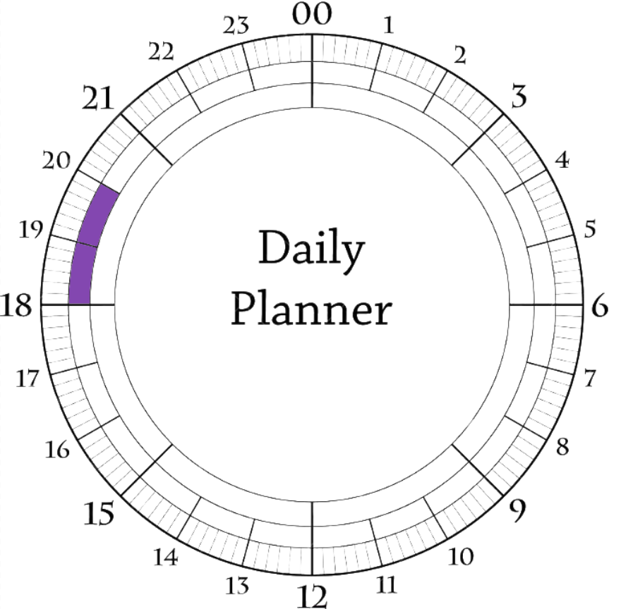
Attack Summary—Apache
Our alerts for HTTP methods showed a dip in GET requests by 2/3rds but an extreme increase in POST requests by 13x Looking at the Cluster map, we saw increased activity from Kiev, Ukraine. The URI pages visited showed a large amount of activity in the ‘/VSI_Account_logon.php’’
Our conclusion is that an Attacker from Kiev ran a brute force attack on the server. The GET requests at 6pm were for the logstash-1.3.2-monolithic.jar URI, which is an archive that may have provided the attackers with information. This information may or may not have been relevant to the POST activity at the login page at 8:06pm. The rapid succession leads us to believe they used a tool for this.
Kiev (439), Kharkiv (433), D.C. (714), and NYC(549) all had high volumes of activity.

Slide 33
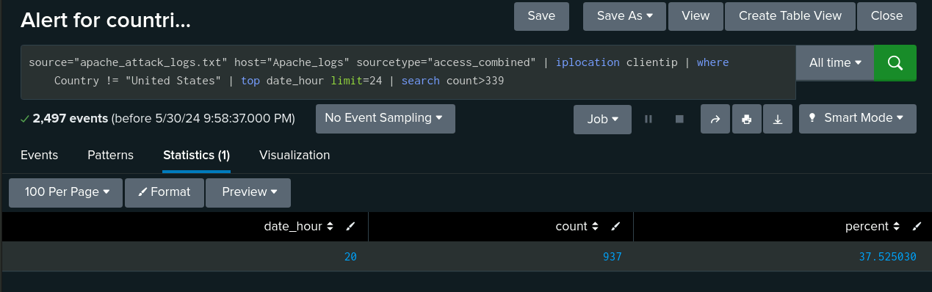
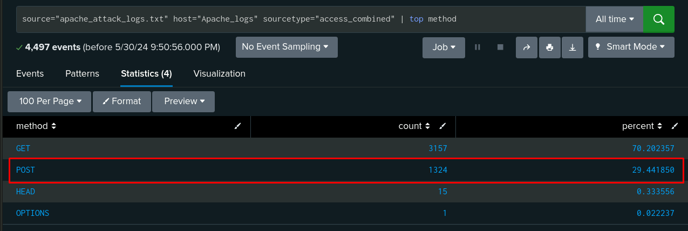
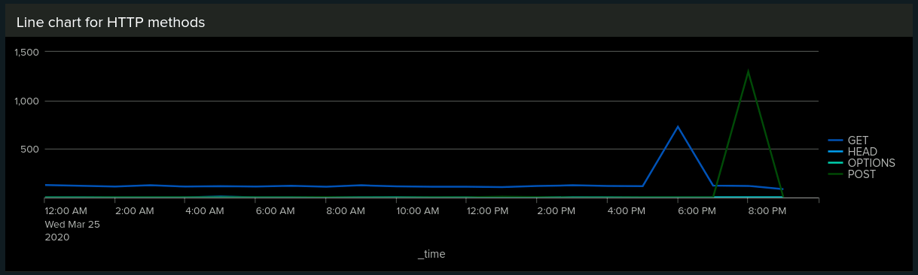
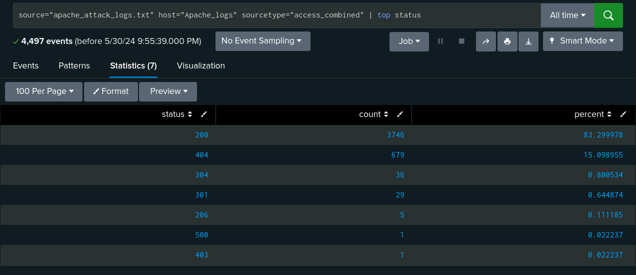
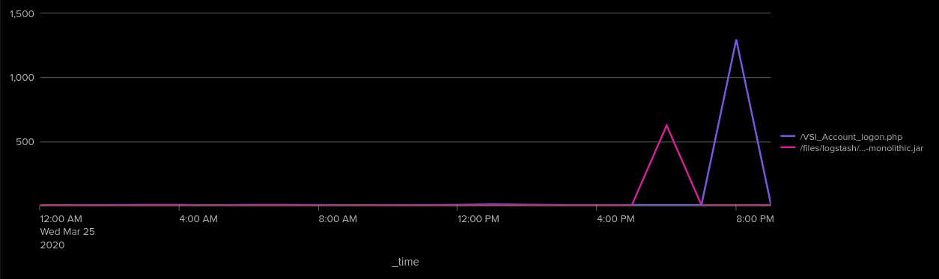
Screenshots of Attack Logs
Alert triggered for activity outside of US. A threshold of 339 was surpassed.
Post attack report of HTTP methods indicating a significant increase in POST method
A line chart indicating the increase in GET and POST methods.
Post attack report of HTTP response codes indicating Significant reduction in 200 OK response code 9726 to 3746 Increase in 404 NOT FOUND response codes 213 to 679
A line chart indicating the increase in the two URI’s accessed

Slide 34
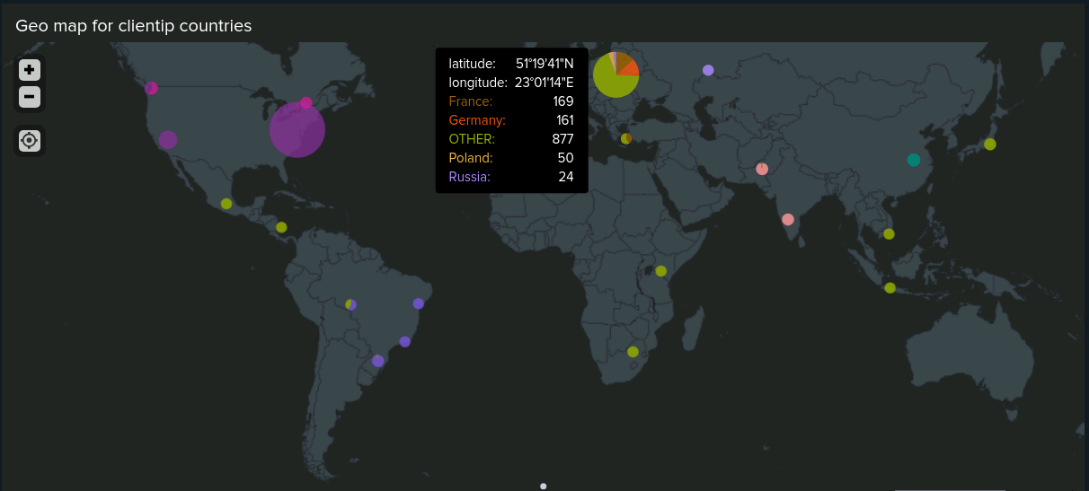
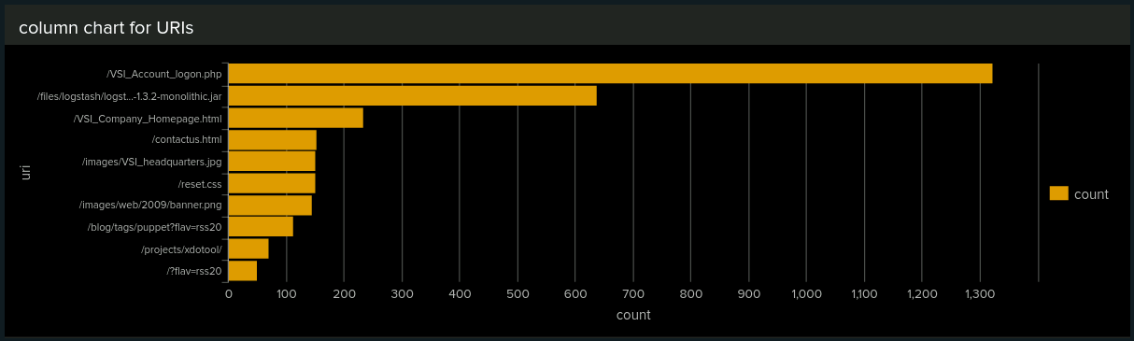
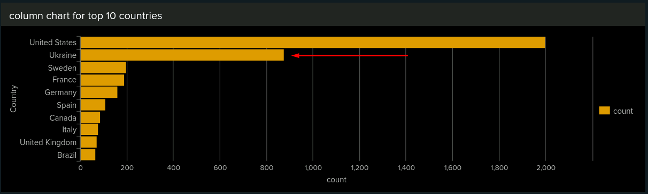
Screenshots of Attack Logs
Cluster map indicating Increased activity from Europe, specifically Ukraine’s activity has increased substantially.
Column chart indicating increased activity for the URI /VSI_Account_logon.php - from 101 to 1323 hits
Column chart indicating Ukraine’s activity has increased substantially.

Slide 35

Summary and Future Mitigations
‹#›

Slide 36
Project 3 Summary
What were your overall findings from the attack that took place?
Our overall finding found that on March 25th VSI had multiple attacks on there Windows and Apache servers. These attacks mainly consisted of BruteForce Password spraying.
To protect VSI from future attacks, what future mitigations would you recommend?
Two-factor authentication, the first line of defense against Brute Force attacks. Setting up a traffic blocker based on high activity from the same location using a WAF or similar system.
Upgrade the protocol from HTTP to HTTPS. Better and more complex baselines to account for this type of event.

Slide 37

‹#›
Notes:
Thank you all

